Slide 1
Bag of Tricks
for Image Classification

Slide 2
For Better Performance(Single Model)
Better Network Architecture
Use better model – ex) ImageNet SOTA
More layers
More channels
Use better activation function – ex) swish, etc.
Use additional architecture – ex) skip connection, SE-module, etc.
Training Tricks!

Slide 3
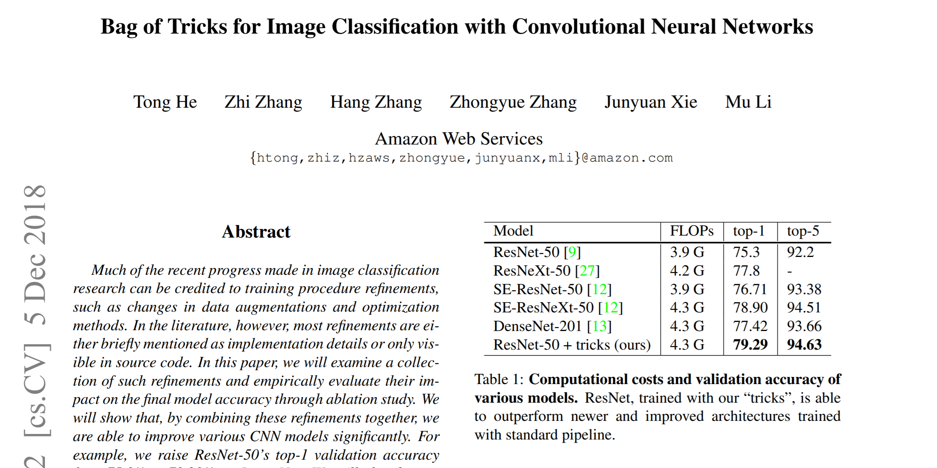
Bag of Tricks for Image Classification

Slide 4
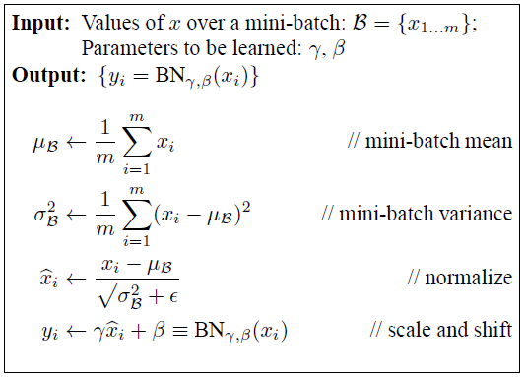
Bag of Tricks for Image Classification
Efficient Training
Linear scaling learning rate
Learning rate warm up
Zero gamma in batchnorm
No bias decay
Low-precision training

Slide 5
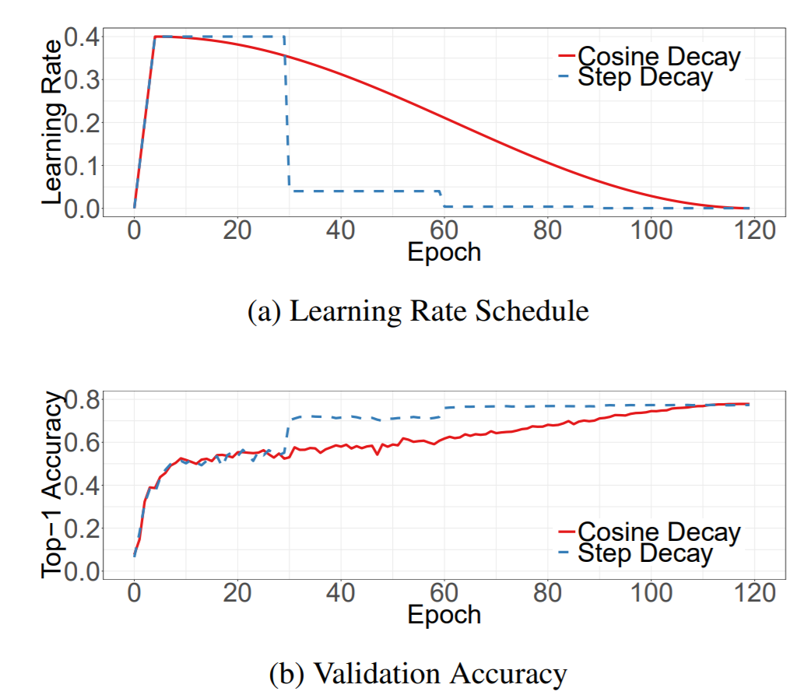
Bag of Tricks for Image Classification
Training Refinements
Cosine Learning Rate Decay

Slide 6
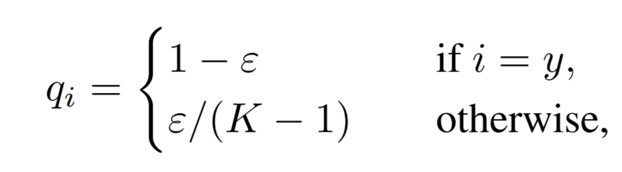
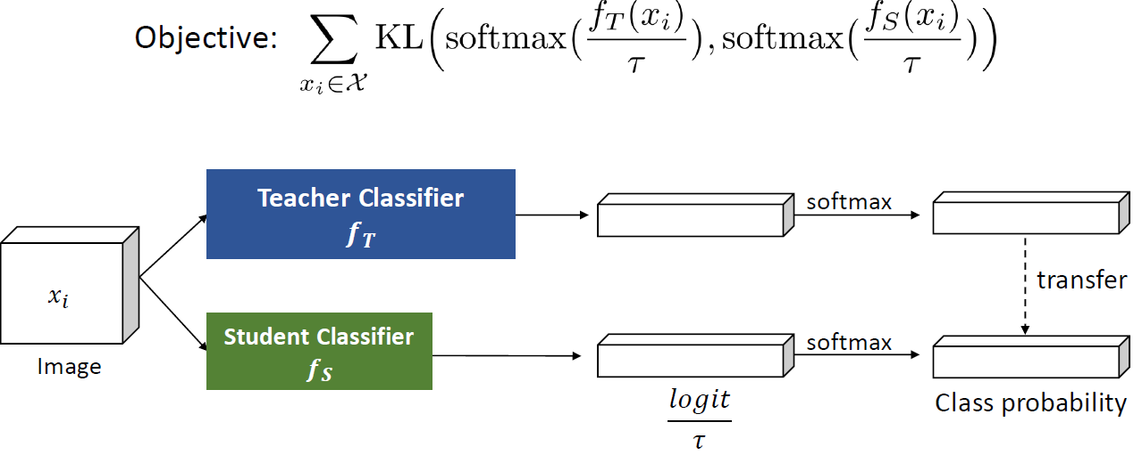
Bag of Tricks for Image Classification
Training Refinements
Label Smoothing
Knowledge Distillation

Slide 7
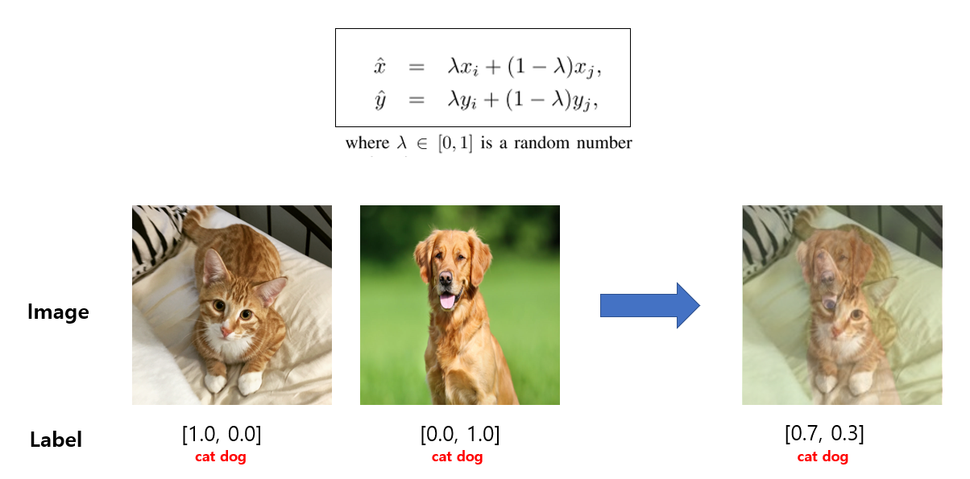
Bag of Tricks for Image Classification
Training Refinements
Mixup Training

Slide 8
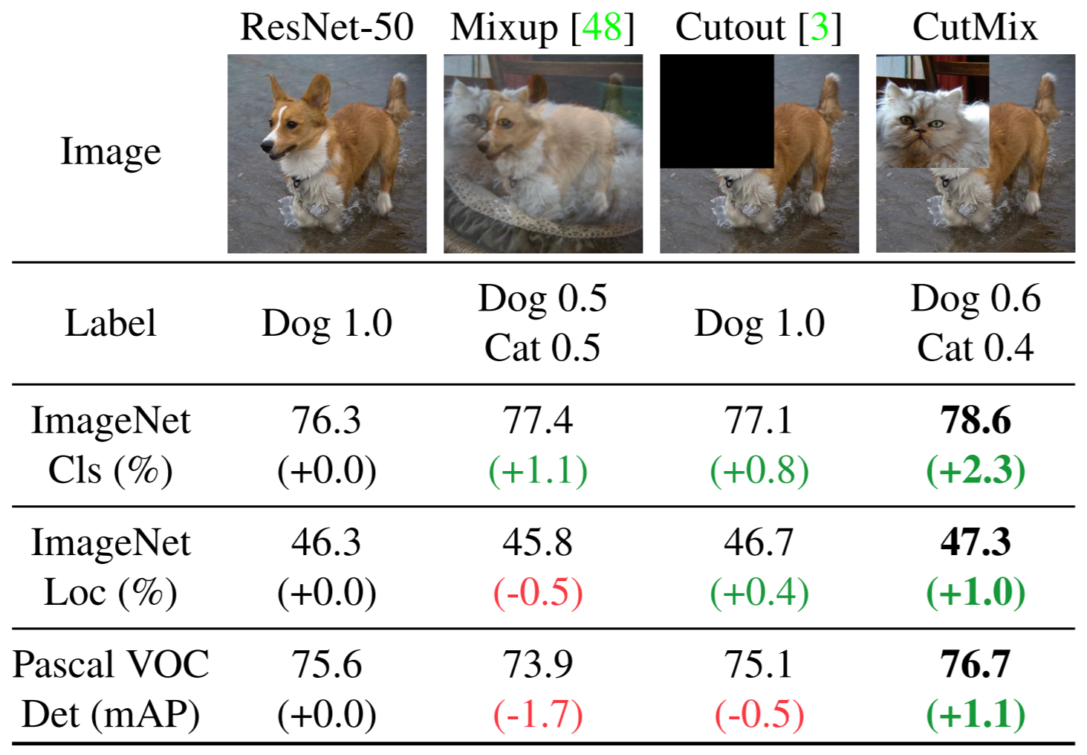
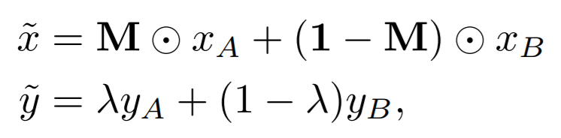
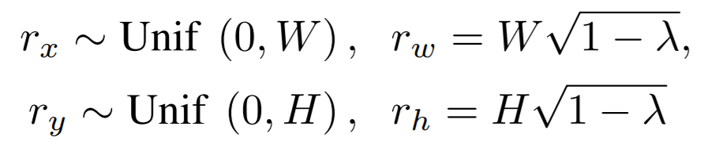
Bag of Tricks for Image Classification
Cutmix

